Slide 1




Portfolio III
Kia R. Felder Williams
Special Education/Qualitative Research Methods
www.KiaFelderWilliamsPortfolio.com
January 18, 2024
1:30 PM

Slide 2

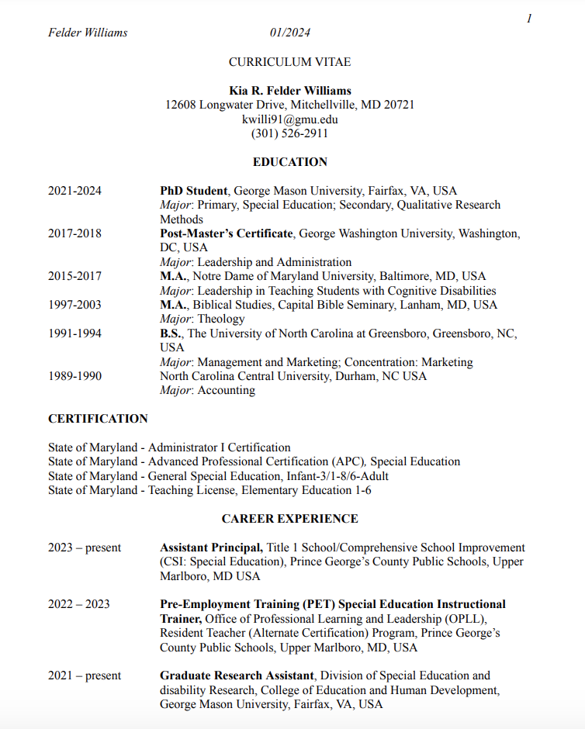
Updated Vitae
1

Slide 3





CV: Education
Bachelor’s Degree
1991-1994
Management & Marketing
Concentration: Marketing
University of
North Carolina at Greensboro
Greensboro, NC
Master’s Degree
1997-2003
Biblical Studies
Concentration:
Theology
Capital Bible
Seminary
Lanham, MD
Master’s Degree
2015-2017
Leadership in Teaching
Concentration:
Students with Learning Disabilities
Notre Dame of Maryland University
Baltimore, MD
Post Masters
2017-2018
Leadership & Administration
George
Washington
University
Washington, D.C.
Doctor of Philosophy
2021-2024
Special Education
George Mason
University
Fairfax, Virginia

Slide 4



CV: Additions Since Portfolio II
Thinking Thursdays Professional Development Café. Weekly PD on culturally responsive teaching, Academic Interventions, Specially Designed Instruction (SDI), and Family Engagement.
presentations
King-Sears, M. E., Banks, J., Christy-Davila, A., Felder-Williams, K., Mergen, R. L., & Sanborn Owens, L. S. (2022). Understanding experiences of BIPOC children and adults with ADHD: Prevalence, perspectives, and access. Children and Adults with Attention-Deficit /Hyperactivity Disorder (CHADD).
publications
Maryland, Advanced Professional Certification
APC, Teacher Licensure;
Special Education; infant – adult (2023-2028)
certifications

Slide 5

Program of
Study
2

Slide 6
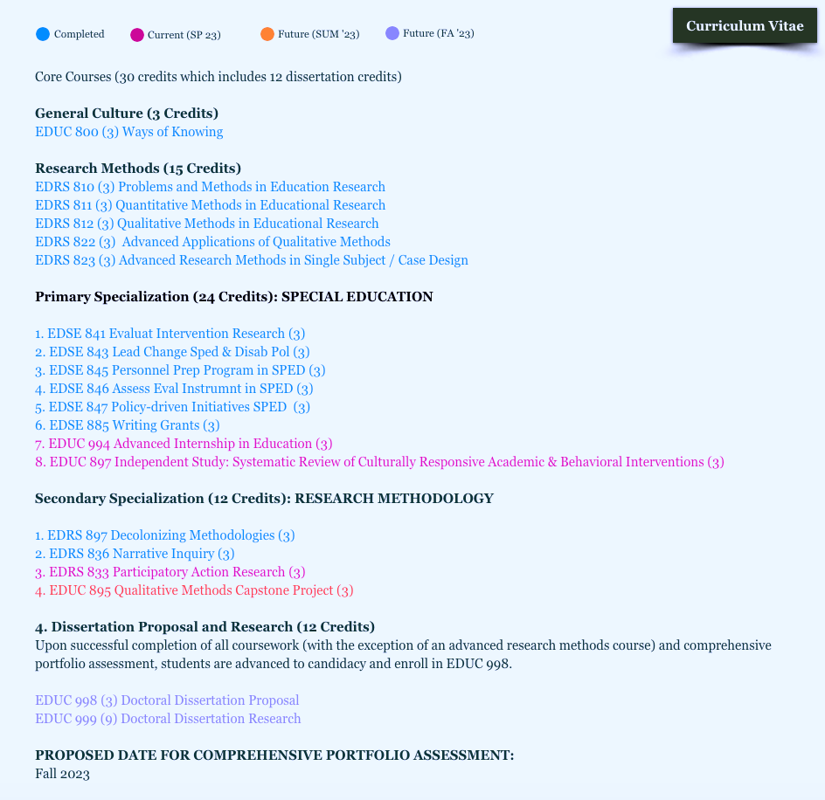
Program of Study
(SP ’24)
(SP ’24)
Proposed (SM ’24)
​General Culture (3 Credits)
EDUC 800 (3) Ways of Knowing
​
Research Methods (15 Credits)
EDRS 810 (3) Problems and Methods in Education Research
EDRS 811 (3) Quantitative Methods in Educational Research
EDRS 812 (3) Qualitative Methods in Educational Research
​EDRS 822 (3) Advanced Applications of Qualitative Methods
EDRS 823 (3) Advanced Research Methods in Single Subject / Case Design
​
Primary Specialization (33 Credits): SPECIAL EDUCATION
1. EDSE 841 (3) Evaluat Intervention Research
2. EDSE 843 (3) Lead Change Sped & Disab Pol
3. EDSE 845 (3) Personnel Prep Program in SPED
4. EDSE 846 (3) Assess Eval Instrument in SPED
5. EDSE 847 (3) Policy-driven Initiatives SPED
6. EDSE 885 (3) Writing Grants
7. EDUC 994 (3) Advanced Internship in Education
8. EDUC 897 (3) Independent Study: Sys Review of CR Ac & Beh Int
9. EDUC 890 (3) Writing and Managing Grants: Theory
10. EDUC 897 (6) Managing Grants: Practice

Slide 7
Program of Study
(SP ’24)
(SP ’24)
Proposed (SM ’24)
Secondary Specialization (12 Credits): RESEARCH METHODOLOGY
1. EDRS 897 (3) Decolonizing Methodologies
2. EDRS 836 (3) Narrative Inquiry
3. EDRS 833 (3) Participatory Action Research
4. EDUC 897 (3) Independent Study: Classroom Management CRT Self-Efficacy Inventory
Dissertation Proposal and Research (12 Credits)
EDUC 998 (9) Doctoral Dissertation Proposal
EDUC 999 (3) Doctoral Dissertation Research
PROPOSED DATE FOR COMPREHENSIVE PORTFOLIO ASSESSMENT: JANUARY 2024

Slide 8



Program of Study Roadmap (Since Portfolio II)
Secondary Specialization
EDRS 833
Participatory Action Research
EDSE 897
EDUC 994
SP ‘23
Proposal
Dissertation
EDUC 998
SP ’24
Dissertation
Defense
FA ’24
FA ‘22
Secondary
Specialization
EDUC 897 Independent Study
(Culturally Responsive Teacher Self-Efficacy)
SUM ‘23
Proposal
Dissertation
EDUC 999
SUM ’24

Slide 9
A.P.R. Goals
& Reflections
3

Slide 10

Theory of
Mind
INTERSECTION OF RACE & DIS/ABILITY
Disproportionate representation of Black and Indigenous People of Color (BIPOC) in special education.
Cultural Humility & Cultural Responsiveness as disruptors to the overidentification and subsequent overrepresentation of black and brown children in SpEd.
1
Redefining race and ability.
(Decolonizing Disability)
Deconstructing the perception of disability in BIPOC communities (to include stigma and stereotypes) and its impact on care and treatment.
Teacher preparedness to implement CRT

Slide 11

Streamlined
Focus
&
Research Interest
INTERSECTION OF RACE & DIS/ABILITY
Researching Black caregivers
perception of the symptoms of Autism (including behaviors, differing behaviors and stereotypy) and the impact on recommendations of related services and interventions.

Slide 12

Professional Update & Reflections
Personal
Reflection
Streamlined research focus
Research
Focus
Black caregiver perception of their child’s ASD symptoms and impact on recommendations for related services and interventions.
Current
Research
Methodology
Personal reflection of studies
QualRes
DisCrit Framework
Narrative Inquiry
Preliminary Literature Review on Black caregiver perception and disability
(SLD, OHI, ASD)

Slide 13

A.P.R. GOALS
ACADEMIC |PROFESSIONAL | RESEARCH GOALS
academic
Continue my doctoral journey, taking Proposal in Spring 2024, and cultivating other academic opportunities. My goal is to defend my dissertation before December 2024.
professional
Academia.
Secure a teaching position in higher education teaching topics of
Intersectionality & Disability and Qualitative Research Methods.
research
Black caregivers perception of the symptoms of ASD, and how such experiences impact their recommendation of related services and interventions.

Slide 14

Analytic Personal
& Professional Essay
4

Slide 15
Continual Engagement in My Professional Community
K-12 Education
Special educator, PGCPS
Elementary school Administrator
Professional Development
Facilitator
  culturally responsive classroom management
  Adapted behavioral interventions
  Professional Learning Community (PLC) for novice educators

Slide 16
Continual Engagement in My Professional Community
Independent Study (SUM ‘23)
CRCMSE, (Siwatu, 1997; Bandura, 1997)
  Examined the CRCM self-efficacy of PGCPS novice educators.
  40 participants; 35 question Likert survey
  Determined most/least efficacious behaviors; completely confident, moderately confident, and not confident at all
  These data were analyzed and the strength index and mean were calculated.
  8, 14, 16, 21, 34 least efficacious
  Follow up interviews were coded for emergent themes.
Notes:
A lack of teacher preparation continues to exacerbate issues of behavior management and discipline.
With schools and classrooms becoming increasingly diverse, research has not addressed issues germane to students from a variety of cultural and linguistic backgrounds (Weinstein et al., 2004; Milner, 2008). The current research on educator agency, self-efficacy, perceived support, and strategies to prepare educators for work with diverse learners must continue.

Slide 17


Knowledge
Evidence
Paper
CAREGIVER
PERCEPTION
5
AUTISM
SYMPTOMS
SERVICES

Slide 18
Caregivers Perceptions of ASD Symptoms on Recommendations for Related Services and Interventions
As of 2021-22,
7.3 million children receive special education or related services under IDEA (National Center for Educational Statistics (NCES), 2023).
15% of all students receive a public-school education.
12% of the population have ASD,

Slide 19
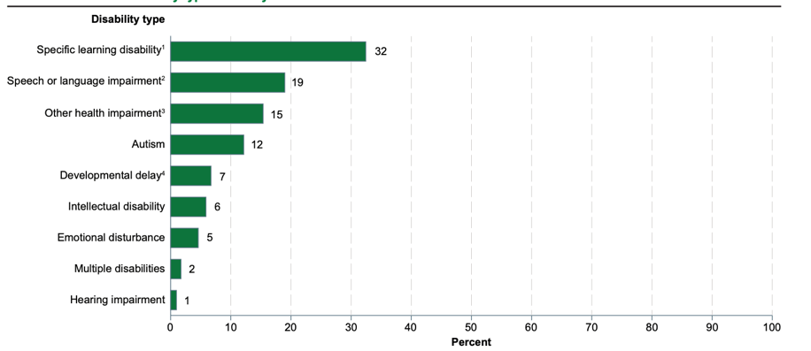
Percentage distribution of students ages 3–21 served under the Individuals with Disabilities Education Act, by selected disability type: School year 2021–22.

Slide 20
Autism Spectrum Disorder (ASD)
“a neurodevelopmental disorder characterized by social interaction, verbal and nonverbal communication difficulties. Characteristics are generally evident before age three and adversely affects a child’s educational performance.”
IDEA, 300.8(c)(1)

Slide 21
ASD occurs in all racial, ethnic, and socioeconomic groups.
1 in 36 eight-year-old children has ASD
  2021: 1 in 44,
  2006: 1 in 110
  2000: 1 in 150
These estimates are historically the highest ever recorded

Slide 22
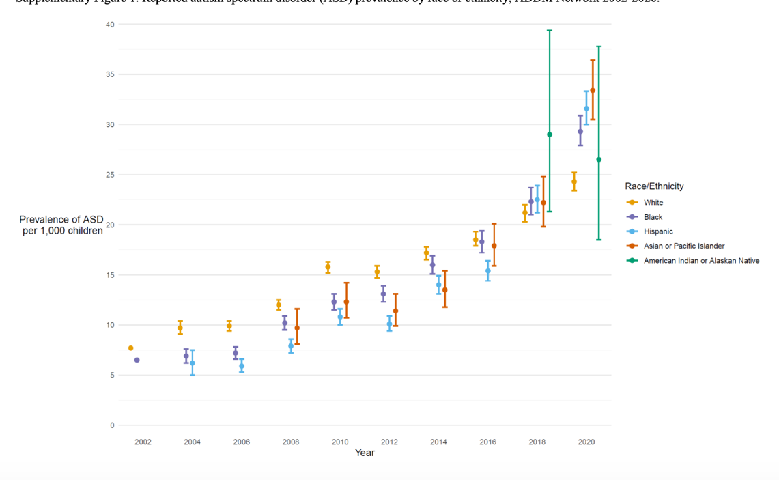
Notes:
Reported autism spectrum disorder (ASD) prevalence by race or ethnicity, ADDM Network 2002-2020.

Slide 23
The prevalence rates of ASD is now lower among White children than among children of other races and ethnicities;
  Thus reversing the direction of past racial and ethnic differences in ASD prevalence.
  Black children, second highest percentage of total enrollment, 17%.

Slide 24
Symptomology/Stereotypies
Symptoms have been identified in children as young as 12-14 months of age and diagnosed with certainty by age 2
However, the average age of diagnosis is between 4-7 years of age
This delay is even more pronounced (+3 years) with children from lower income, ethnic/racial minority, and rural backgrounds. Although ASD is prevalent, with strong biological and genetic markers, the reporting of symptoms, and willingness to seek support is impacted by sociocultural factors.

Slide 25
Parent Perception & Beliefs
There is little research examining causal beliefs and perceptions of Black caregivers.
When controlling for SES, 58% of Black mothers' attribute ASD to vaccinations, whereas 37% of White parents ascribe to the same philosophy (Bazzano et al., 2012; Rivera-Figueroa, 2022).
Beliefs that ASD is a mystery (Zuckerman et al., 2015) or a result of trauma (Dardennes et al., 2011) are associated with reduced behavioral intervention.
Few studies have compared causal beliefs about ASD or how these beliefs impact service use across racial groups.
Notes:
Viewing ASD as a mystery can impact service consideration and use. A study of 305 mothers of children with ASD reported that those who described ASD as a mystery used more ASD intervention services, regardless of severity, race, ethnicity, or language (Reyes et al., 2018).
Misconceptions likely contribute to reduced service use.

Slide 26
Purpose
& Significance
PURPOSE & SIGNIFICANCE
ASD is under-researched in multicultural populations¹, and even more limited in its study of ASD and Black families. Research of culturally based differences in perception is a critical genesis in determining whether Black caregivers have unique beliefs that impact a disparate diagnosis or impact recommendation for related services and interventions.
¹ (Dyches et al., 2004; El-Ghoroury & Krackow, 2012; Mandell & Novak, 2005)

Slide 27
Research Framework
A Dis/ability Critical Race (DisCrit) Theoretical framework is utilized to help one interpret and better understand Black experiences in racist, gendered, and ableist contexts¹ and challenges what constitutes knowledge.¹
DisCrit combines Critical Race Theory and Disability Studies, and provides a theoretical foundation for analyses.²
DisCrit is operationalized through 7 tenets.
¹ (Drame et al., 2020),
² (Annamma et al., 2013; Meekosha and Shuttleworth, 2009)
Notes:
In order to operationalize DisCrit in ways that would be most useful to scholars in both fields, Annamma et al (2013) drew on foundational intersectional and critical frameworks to develop a series of tenets that are perceived as integral to an intersectional approach to disability and race.

Slide 28
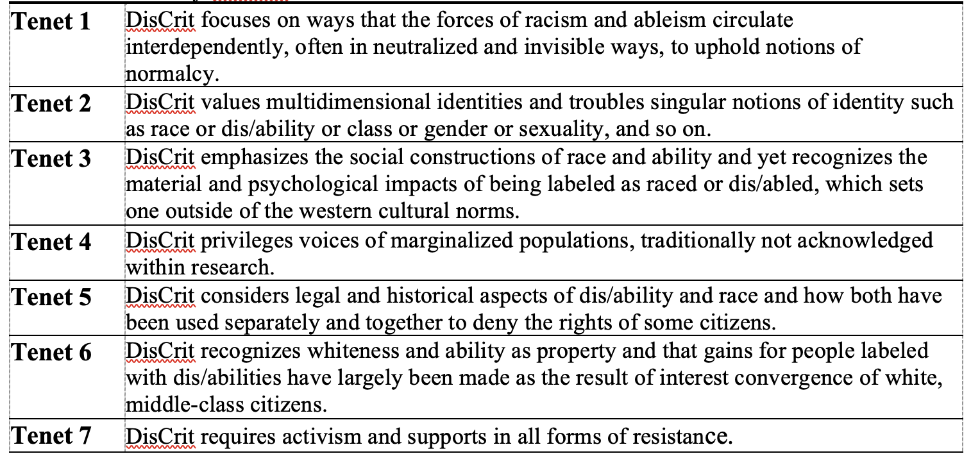
7 TENETS OF DISCRIT
Notes:
The theoretical framework I will utilize is DisCrit focusing on Tenets 3 and 4. Tenet 3 emphasizes the social constructions of race and ability and yet recognizes the material and psychological impacts of being labeled as raced or dis/abled, which sets one outside of the western cultural norms, and tenet 4, privileges voices of marginalized populations, traditionally not acknowledged within research.

Slide 29
Method
Narrative inquiry and DisCrit lens;
Capture difference versus deficit and lived experiences of caregivers maneuvering the system that has historically disabled race and racialized ability (Hart et al., 2009; Annamma et al., 2013)
This research foci and purpose fills a critical knowledge gap
Entry point for understanding how Black caregivers of children with ASD view characteristics of the disorder/disability and how such perceptions impact parents’ involvement in the selection of services and intervention.
Notes:
Narrative research highlights people’s lived experiences and can be used as a starting point for understanding how people make sense of their lives and for understanding how and why people’s stories are shaped and reshaped. The progression of this type of research that moves the narrative beyond simply telling the story to an understanding of the broader social and historical significance is compelling (Ravitch and Carl, 2021).
***Overall, we see how legal policies have racialized dis/ability and therefore made students of color with dis/abilities the beneficiaries of a double-edged sword wherein they receive specialized services due to the dis/ability label, but endure segregation, stigmatization and ‘debatable quality of educational outcomes’ (Hart et al. 2009).

Slide 30
Academic
Archive
(additions since February 2023)
Link to Current Unofficial Transcript
6

Slide 31
EDRS 833: Participatory Action Research
I wanted to send an email… Thank you for your flexibility as we navigated the semester and [stayed] true to CPI's epistemological commitment to humility, openness, and relationality. As we built relationships and worked together, our learning was, in my experience, deepened beyond what it would have been by staying laser focused on what was written in the syllabus.
Megan Call-Cummings
The Collective – PAR class project and research collective
The Collective - Codes
EDUC 897: Literature Review: Culturally Responsive Teaching Preparedness in Novice Educators
Literature Review

Slide 32


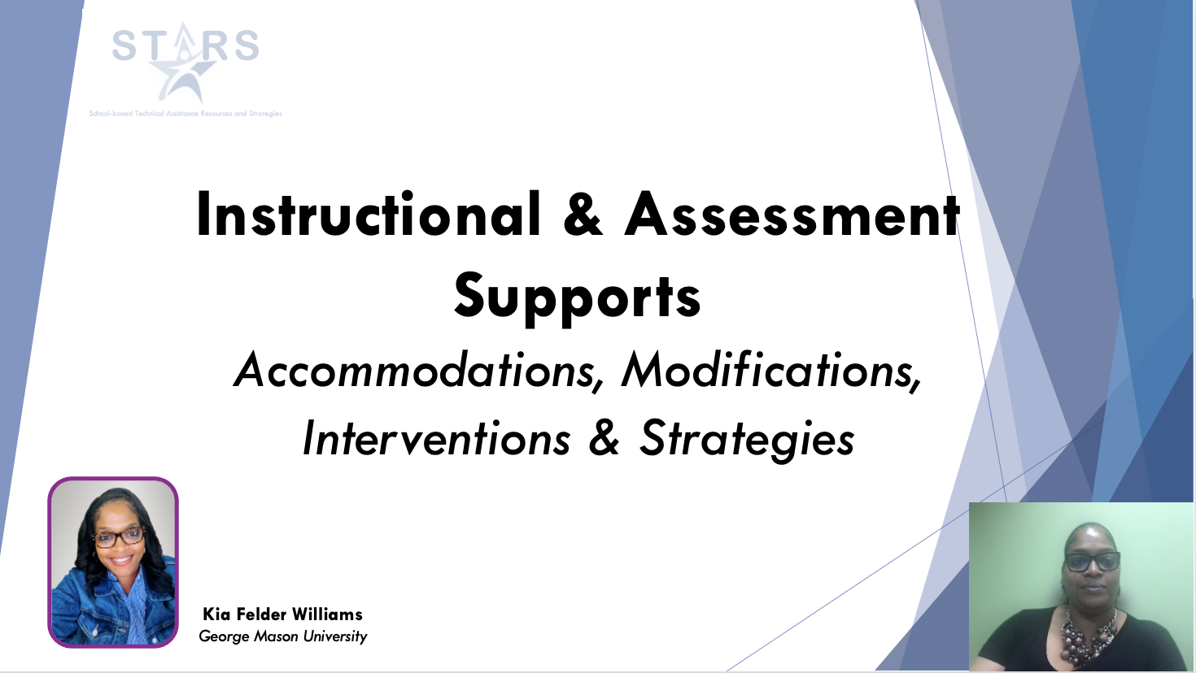
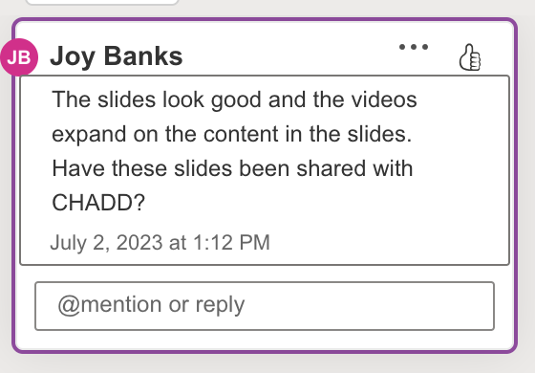
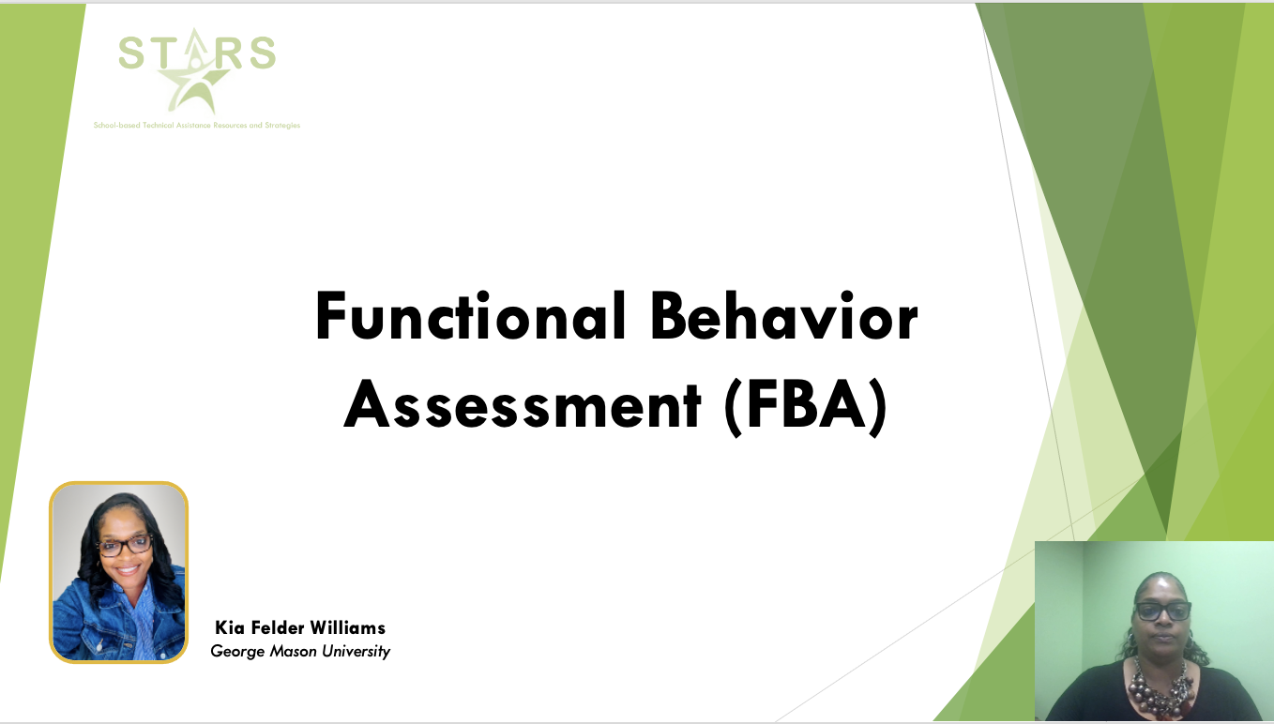
EDUC 994: Teachers, ADHD, and CLD Students
Designed modules for Teacher 2 Teacher University

Slide 33


Dr. Banks,
Dr. Evmenova
&
Dr. Regan for your guidance and support on my doctoral journey.
thank you!

Slide 34
Research Question | Interview Questions
How do Black parents of students with ASD perceive the symptoms of ASD that their children exhibit? | Tell me about the definition of ASD What was your knowledge of ASD prior to your child’s diagnosis? Do you feel that the diagnosis is accurate? Do you think Black students exhibit characteristics of ASD that are not part of the definition?
To what extent have parents been involved in the decision-making process of their child’s related services and academic interventions in special education? | Tell me how you have been involved in the referral process? Do you feel your child’s academic progress is monitored? Tell me how the interventions were chosen for your child.
How have parents used the IEP meeting to monitor their child’s academic progress and growth in related services? | How often do you attend IEP meetings? Tell me about how you speak up for your child in the meetings? What is your knowledge of the IEP meeting process? How do you ensure that you feel equipped to share and ask questions in the meetings? Tell me some of the ways your child’s progress is demonstrated to you in the IEP meeting.

