Slide 1
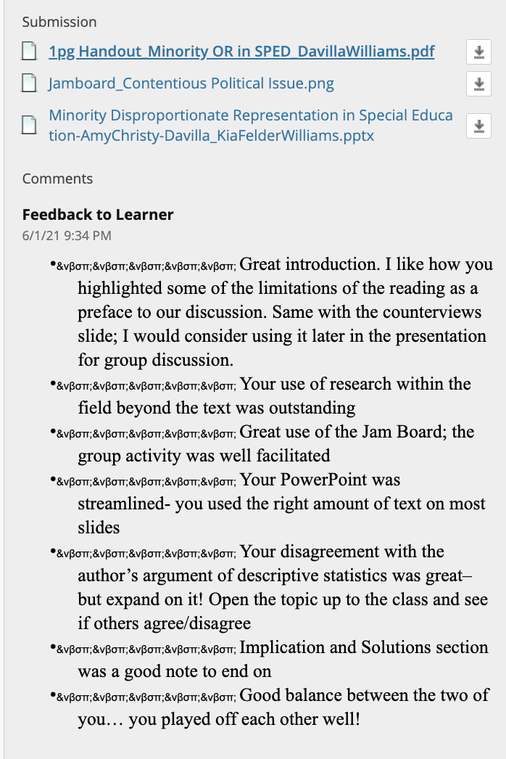

Slide 2
Minority Disproportionate Representation in Special Education
Anastasiou, et al (2017)
Politics and Evidence, Issues, and Implications

Slide 3
Anastasiou, et al (2017)
Patterns of Disproportionality
Underlying causes and contributing factors
Legal and policy issues

Slide 4
History of Segregation and
Unequal Access to Education
Based on deficit model and reinforced by law/policy
Native American boarding schools
Denial of education to African Americans matter of law
Separate but equal in Plessy v. Fergusson
Redlining in real estate
English-only education
Redistricting of school and congressional boundaries to exclude African American students and protect power of White voters
1968 – Lloyd Dunn observed that poor and non-white students often deemed “unable to learn” and sent to isolated special education classrooms

Slide 5
Counterviews to Anastasiou and Kauffman
Whitford & Carrero (2019)
Artiles (2019)
Connor, et al. (2019)
Refusal to discuss race leaves the ways in which racism is interwoven in the fabric of our society unchallenged.
Strict adherence to positivism = embracing of medical model of disability.
For positivists or traditionalists, “Historical and institutional racism is assumed to be sufficiently acknowledged…”
Racism cannot be “bracketed” or divorced from special education.
Identification for special education based on two requirements:
1. Presence of a disability
2. Need for specially
designed instruction.
For Anastasiou and Kauffman, poverty and cultural differences” = “disorders.”
CLD students may be denied access to education that offers capital.
“The sculpting of (in)competence with ephemeral categories” allows race to be visible at times and invisible at others.
Disability identification of White and students of color do not have the same meaning or consequences
Special education identification practices are not the “‘result of neutral sorting and choice’ (Harris, 2001, p. 1774, emphasis added).”
The nature of race skews resources, access, and power.

Slide 6
Patterns of Over-representation
Anastasiou, et al (2017)

Slide 7
Icebreaker
Why has disproportionality become such a contentious political issue?
Notes:
Racial bias
Discriminatory eligibility procedures
Underlying socioeconomic and other structural inequities
ID and ED carry a stigma of inferiority/antisocial behavior
Effectiveness of special education
More and less integrated settings
Identity politics

Slide 8
Reported Patterns of Over-representation
Occurs when minority children experience a higher-than-expected likelihood of being in special education
"Judgmental" categories: ID (2.3x), ED (2.1x), SLD (1.5x)
Historically African Americans are identified as ED, ID (OSEP)
For almost two decades, the change in disproportionality of AA in all disabilities has only been .1%
More restrictive settings (DeValenzuela, et al., Skiba et al.)
Notes:
Definition
Identification
LRE- underrepresented in gened settings. (In pull out less than 21% and in gen ed greater than 60%); Special classes, special schools

Slide 9
Disproportionality in Subgroups English Language Learners
(Umansky et al., 2017)
Ever-English Learner
English Learners are overrepresented in special education at the secondary level.
Disability or lack of appropriate interventions?
Lack of Early Identification
English Learners may be underrepresented at the elementary level.
Is learning difficulty result of disability or language difference?
Long-Term English Learners
English Learners with disabilities are far less likely to exit programs for ELs. Are services for these students appropriately ambitious?

Slide 10
Disproportionality in Subgroups Asian Americans and Pacific Islanders
(Sullivan et al., 2020)
Failure to Recognize Heterogeneity of AAPI Students
AAPI students do not share a single culture and language.
How have AAPI students been affected by varying degrees of colonialism?
MMM Theory
Differences among AAPI students contradict the model-minority myth (MMM).
Ethnicity, immigrant/ refugee status, and socioeconomic factors influence achievement.
Pan-ethnic Studies Obscure Differences
Risk ratios are different for Asian Americans and Pacific Islanders in several disability categories.
How can this help in addressing disproportionality?

Slide 11
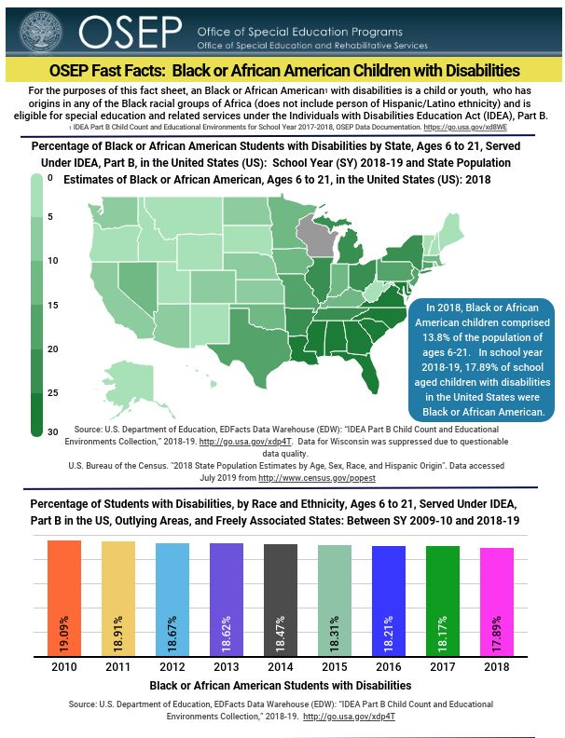
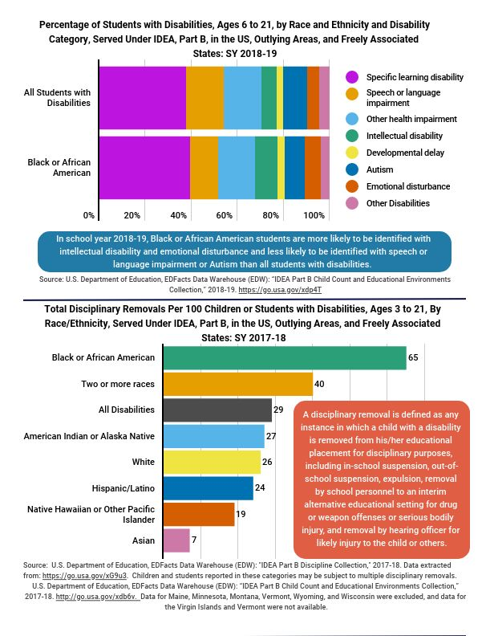
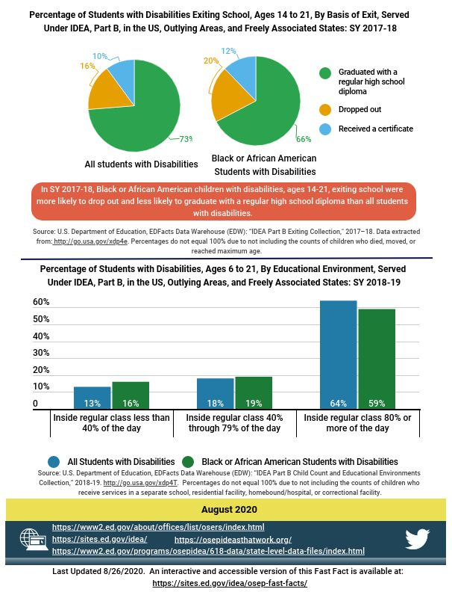
Look at the OSEP Fast Facts, Black or African American Children with Disabilities:
African Americans comprise less than 14% of the population. What can you infer from the statistics?
What are some things you notice about identification, placement, discipline, exiting?
Any wonderings?
https://sites.ed.gov/idea/osep-fast-facts-asian-children-with-disabilities-20/
https://sites.ed.gov/idea/osep-fast-facts-american-indian-or-alaska-native-children-with-disabilities-20/
https://sites.ed.gov/idea/osep-fast-facts-black-or-african-american-children-with-disabilities-20/
https://sites.ed.gov/idea/osep-fast-facts-hispanic-latino-children-disabilities-20/
OSEP Fast Facts

Slide 12
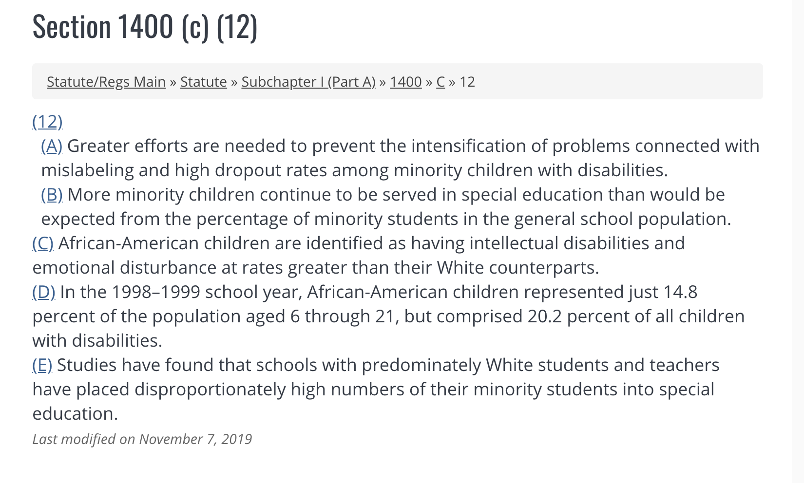
v
https://sites.ed.gov/idea/statute-chapter-33/subchapter-i/1400/c/12
Notes:
Disparities explained by widespread over-identification based on race/ethnicity.
1997, 2004 amendments to IDEA
Goal: Greater compliance monitoring

Slide 13
Limitations to Descriptive Statistics
May result in mistaken conclusions.
Other mechanisms may be responsible for the observed patterns.
Misdirected legislative, policy, and advocacy efforts.
Descriptive statistics are insufficient to draw causal explanations.
Notes:
Causal explanations – ex. . (i.e. drawing inferences of racial bias from findings of disparity.)
**Evidence of misidentification based on race or ethnicity requires stronger evidence than reports of disparities provided simply through descriptive statistics.

Slide 14
Exploring Potential Racial Bias
The National Research Council (2002), Office of Special Education Programs (OSEP) and USDE Office of Civil Rights have called for greater methodological rigor when investigating the explanatory mechanisms responsible for minority over-representation in special education. (i.e. racial bias v. increased exposure to poverty)
Author states OSEP and OCR’s estimates do no adjust for possible confounds:
exposure to poverty
social, environmental, and biological risk factors that increase the likelihood for cognitive, emotional, physical, and biological impairments.

Slide 15
Underlying Causes and Contributing Factors (Politics of Special Education)
Anastasiou, et al (2017)

Slide 16
How Disproportionality Became a Contentious Issue
Special Education began as a civil rights struggle for children with disabilities.
Public Law 94-142 (1975) established the right to an equitable an appropriate education for children with disabilities.
(Civil) rights continue to be extended in the U.S. and other countries.
Debate whether special education identification is discriminatory.
Debate regarding why minority children are overrepresented and at a greater rate.

Slide 17
Four Reasons Why Overrepresentation in Special Education is Problematic
Over-representation is believed to constitute additional evidence of racial bias and discrimination in the U.S.
Special Education labels such as ID and ED might carry a stigma of inferiority or antisocial behavior and perpetuate stereotypical beliefs.
The value of special education in terms of its effectiveness in increasing children’s learning and behavior continues to be debated.
The rise of identity politics.
Notes:
Identity politics - a tendency for people of a particular religion, race, social background, etc., to form exclusive political alliances, moving away from traditional broad-based party politics.

Slide 18
Discussion Question
“Perhaps the key issue in thinking accurately about disproportionality is whether teachers and schools make referrals and find students eligible for special education not based on what they can measure and observe, but rather on unconscious race/ethnic bias.”
Losen, Hodson, Ee & Martinez, 2014; Losen, et al., 2015
Discuss this supposition as a group…

Slide 19
Legal and Policy Issues
Anastasiou, et al (2017)

Slide 20
Anastasiou and Kauffman Cultural Politics
View “cultural politics” or “identity politics” as a new phenomenon.
Argue that special education research ignores factors other than race that impact identification of students who have disabilities.
Consider raw percentages misleading when considering overrepresentation.
Believe that excluding other factors from consideration weakens internal validity of a study.

Slide 21
Counter Arguments
“Misidentifying students from culturally and linguistically diverse (CLD) backgrounds has grave implications whether the medical model or the social constructivist model is applied” (Whitford & Carrero, 2019).
Medical Model of Disability
Social Constructivist Model
Disability is socially constructed.
If deficit is seen as a difference
If difference is seen as a deficit
Services may be seen as unnecessary for this reason.
No services
Intervention imposed
(Whitford & Carrero, 2019)

Slide 22
Implications & Solutions
Anastasiou, et al (2017)

Slide 23
Legal and Policy Implications
States define “inappropriate identification.” This means that many districts have been able to report disproportionality without making significant changes in who is identified, how, and why. (Artiles, 2019).
Legislation and policy that penalize for overrepresentation do not address the problem, but providing resources might (Whitford & Carrero, 2019).
Teacher preparation should address bias and develop cultural responsiveness and competency (Whitford & Carrero, 2019).

Slide 24
Implications for Research
Artiles (2019) – “We need studies on the spaces between what laws and policies are and what laws and policies do. . .”
Material consequences of disability need further study (Artiles, 2019).
Studies that focus solely on quantitative measures lack the depth that qualitative data can provide. A multifaceted view is required to understand the experiences of students. (Artiles, 2019; Connor et al., 2019).

Slide 25
References
Anastasiou, D., & Kauffman, J. M. (2019). Cultural politics, ideology, and methodology in disproportionality research: A rejoinder. Journal of Disability Policy Studies, 30(2), 105–110. https://doi.org/10.1177/1044207319863647
Anastasiou, D., Morgan, P. L., Farkas, G., & Wiley, A. L. (2017). Minority Disproportionate Representation in Special Education: Politics and Evidence, Issues, and Implications. In Handbook of Special Education (2nd ed.). Routledge.
Artiles, A. J. (2019). Fourteenth Annual Brown Lecture in Education Research: Reenvisioning Equity Research: Disability Identification Disparities as a Case in Point.Educational Researcher, 48(6), 325–335. https://doi.org/10.3102/0013189X19871949
Connor, D., Cavendish, W., Gonzalez, T., & Jean-Pierre, P. (2019). Is a bridge even possible over troubled waters? The field of special education negates the overrepresentation of minority students: a DisCrit analysis. Race Ethnicity and Education, 22(6), 723–745. https://doi.org/10.1080/13613324.2019.1599343
Kauffman, J. M., & Anastasiou, D. (2019). On cultural politics in special education: Is much of It justifiable? Journal of Disability Policy Studies, 30(2), 78–90. https://doi.org/10.1177/1044207318822262
Sullivan, A. L., Kulkarni, T., & Chhuon, V. (2020). Making visible the invisible: Multistudy investigation of disproportionate special education identification of U.S. Asian American and Pacific Islander students. Exceptional Children, 86(4), 449–467.
Umansky, I. M., Thompson, K. D., & Díaz, G. (2017). Using an Ever-English Learner Framework to Examine Disproportionality in Special Education. Exceptional Children, 84(1), 76–96.
Whitford, D. K., & Carrero, K. M. (2019). Divergent discourse in disproportionality research: A response to Kauffman and Anastasiou (2019). Journal of Disability Policy Studies, 302), 91–104. https://doi.org/10.1177/1044207318822264

Slide 26
Minority Disproportionate Representation in Special Education
Anastasiou, et al (2017)
Politics and Evidence, Issues, and Implications
kwilli91@gmu.edu
achristy@gmu.edu

