Slide 1
INTRODUCTION
LITERATURE REVIEW
METHOD
REFERENCES
TPP CANDIDATE PERCEPTION OF CULTURALLY RESPONSIVE TEACHING SELF-EFFICACY
A Qualitative Research Proposal

Slide 2
TPP CANDIDATE PERCEPTION OF CULTURALLY RESPONSIVE TEACHING SELF-EFFICACY
A QUALITATIVE RESEARCH PROPOSAL
LITERATURE REVIEW
SLIDE 7
SLIDE 8
METHOD
SLIDE 13
STATEMENT OF PURPOSE
RESEARCH QUESTIONS
SLIDE 11
SLIDE 12
INTRODUCTION
SLIDE 3
THE RATIONALE
SLIDE 5
RESEARCH DESIGN
SLIDE 14

Slide 3
INTRODUCTION OF THE TOPIC
TPP CANDIDATE PERCEPTION OF CULTURALLY RESPONSIVE TEACHING SELF-EFFICACY
79.3% of public school teachers are white;
9.3 percent are Hispanic;
7% Black, and;
2% Asian¹
More than 50% of the student population is of color and greater than 20% of students live in poverty². Schools are projected to be 54% students of color by 2025, so now is the time to ensure teachers entering the profession are prepared to deliver high-quality instruction to all students.
Ethnic minority and low income students are likely to have teachers whose cultural backgrounds differ from their own. Such cultural dis-synchrony (Irvine, 2003) has contributed to inequitable and sometimes oppressive educational experiences for CLD students.
¹U.S. Department of Education, Teacher and Principal Survey, 2017.
²U.S. Department of Commerce, 2015; U.S. Department of Education, 2018.
Although CRT can have positive effects on student outcomes, little research has examined teachers’ self-efficacy to implement these CRT practices effectively and no research studies could be found regarding TPP candidates perceptions of CRT readiness.

Slide 4
INTRODUCTION OF THE TOPIC
TPP CANDIDATE PERCEPTION OF CULTURALLY RESPONSIVE TEACHING SELF-EFFICACY
With the increasing cultural diversity in schools, many teacher education programs face the challenge of preparing prospective teachers to become culturally responsive educators. Culturally responsive teaching (CRT) practices are central to improving educational outcomes for students from nondominant sociocultural and linguistic communities (Gay, 2002, 2010). Inclusive and equitable classroom instruction requires teachers understand how students’ CLD backgrounds pervade all facets of learning and teaching (Gay, 2010). CRT builds students’ cultural capital and supports academic success by connecting school learning with their background experiences, families and communities.
To use CRT effectively, teacher must be able to access training and gain meaningful experience implementing this type of pedagogy. (Cruz, et al., 2019) In addition to experience and developing this knowledge, aspiring teachers must also develop their own critical consciousness through participation in preparation programs that use guided practice, authentic examples and realistic situations in efforts to help cultivate this form of reflection (Gay & Kirkland, 2003). Deficit beliefs about student abilities are perpetuated when CRT capacity is not built up in educators.

Slide 5
THE RATIONALE: IMPLICATIONS OF SELF-EFFICACY
Self-efficacy refers to a belief in one’s ability to organize and carry out the actions needed to produce desired results.
CRT can have positive effects on student outcomes; however, little research has examined teachers’ self-efficacy to implement CRT practices.
Provides a theoretical lens through which to evaluate teachers’ ability and willingness to implement CRT.
…is associated with a teacher’s ability to more effectively respond to students’ needs
…associated with the development of meaningful curriculum and learning opportunities in the classroom
In terms of teacher outcomes, it is a significant predictor of a teacher’s understanding of students
Despite the positive effects of teacher’s self efficacy, little research has examined the extent to which teachers feel competent specifically in their ability to implement CRT.
Self-efficacy refers to a teacher’s belief that he or she is able to promote and affect student learning in a particular realm.(Bandura, 2007)
Heightened teacher self-efficacy has been associated with positive outcomes for both teachers and students.

Slide 6
LITERATURE REVIEW

Slide 7
LITERATURE REVIEW: SOURCES
TPP CANDIDATE PERCEPTION OF CULTURALLY RESPONSIVE TEACHING SELF-EFFICACY
Cruz, R. A., Manchanda, S., Firestone, A. R., & Rodl, J. E. (2020). An examination of teachers’ culturally responsive teaching self-efficacy. Teacher Education and Special Education, 43(3), 197-214.
Whitaker, M. C., & Valtierra, K. M. (2018). The dispositions for culturally responsive pedagogy scale. Journal for Multicultural Education.
Özüdogru, F. (2018). The Readiness of Prospective Teachers for Culturally Responsive Teaching. Acta Didactica Napocensia, 11, 1-12.
Judd, J. B. Practitioner Research as Catalyst for Culturally Responsive Teaching.
Chu, S. Y., & Garcia, S. B. (2018). Collective teacher efficacy and culturally responsive teaching efficacy of inservice special education teachers in the United States. Urban Education, 0042085918770720.
Cholewa, B., Goodman, R. D., West-Olatunji, C., & Amatea, E. (2014). A qualitative examination of the impact of culturally responsive educational practices on the psychological well-being of students of color. The Urban Review, 46(4), 574-596.
Paris, D., & Alim, H.S. (2014) What are we seeking to sustain through culturally sustaining pedagogy? A loving critique forward. Harvard Business Review, 81(1), 85-137.
Full list of References on SLIDE 29-30.

Slide 8
LITERATURE REVIEW
TPP CANDIDATE PERCEPTION OF CULTURALLY RESPONSIVE TEACHING SELF-EFFICACY
Applying a multi-cultural and interdisciplinary lens to teaching and learning is rooted in a educators’ intentional display of cultural awareness and competence in regards to students’ beliefs surrounding their academic abilities. TPPs face the challenge of preparing prospective teachers for CRT with the ever-increasing cultural diversity in schools (Ozudogru, 2018). Culturally responsive educators are no longer optional, they are required (Kea, 2013) to create safe learning environments that promote teaching and learning that allows each student to identify with and relate to course content from their own cultural context. Teachers who utilize culturally responsive teaching practices value students’ cultural and linguistic knowledge, previous knowledge and learning styles, and view these as a way to ease student learning rather than as a barrier to learning (Aceves & Orosco, 2014; Gay, 2002, Siwatu, 2007).
In an effort to measure the self-efficacy of practicing and preservice teachers, researchers utilized a CRTSE scale to examine areas where teachers felt high and low self-efficacy in their CRT practices (Cruz, et. Al, 2019). The highest mean scores were in areas that involved building trust and personal relationships with students. The lowest mean scores were in areas that involved more specific cultural knowledge such as teaching students about their culture’s contributions to science and math.

Slide 9
LITERATURE REVIEW
TPP CANDIDATE PERCEPTION OF CULTURALLY RESPONSIVE TEACHING SELF-EFFICACY
Additional researchers measured teachers dispositions for CRT using a 19-item scale with an alpha reliability of 0.92 (Whitaker & Valtierra, 2018). The study yielded three dispositional factors: disposition for praxis, disposition for community and disposition for social justice. Gay (2002) pointed out five important components of CRT: 1) developing a cultural diversity knowledge base, 2) designing culturally relevant curricula, 3) demonstrating cultural caring and building a learning community, 4) establishing cross-cultural communications, 5) establishing cultural congruity in classroom instruction.
Further research (Siwatu, et al., 2016) showed that preservice teachers recognized the value and utility of culturally responsive classroom practices, yet doubted their ability to successfully implement them (i.e., agent–means perspective). These self-efficacy doubts stemmed from a general lack of knowledge regarding student diversity and culturally responsive pedagogy and experiences observing and working in diverse educational settings.

Slide 10
LITERATURE REVIEW
TPP CANDIDATE PERCEPTION OF CULTURALLY RESPONSIVE TEACHING SELF-EFFICACY
Additionally, researchers conducted various studies examining preservice teachers’ culturally responsive teaching self-efficacy beliefs (e.g., Siwatu, 2011; Siwatu & Starker, 2010). Their research found that preservice teachers are most self-efficacious in their ability to help students feel like important members of the classroom and to develop positive, personal relationships with their students. However, preservice teachers tend to be less efficacious in their ability to carry out the more difficult aspects of culturally responsive teaching that requires them to be able to integrate students’ culture into the curriculum (e.g., use examples that are familiar to students from diverse cultural backgrounds) and communicate with English Language Learners and their parents (e.g., model classroom tasks to enhance English Language Learners’ understanding; Siwatu, 2007, 2011).

Slide 11
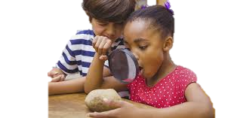
STATEMENT OF PURPOSE
The purpose of this research study is to extend the qualitative research and population of existing research in the self-efficacy of culturally responsive educators. A basis for this research proposal was an existing research study in which the CRTSE³ scale was used to evaluate teacher self-efficacy in implementing culturally responsive teaching (Siwatu, 2007, Fitchett, Starker, and Salvers, 2012). The prior study was conducted in Turkey and focused primarily on the quantitative data from the scale.
The prior studies were considerably smaller and limited to teachers of a specific content area. This study will expand the number of subjects to include all undergraduate seniors in the George Mason University teacher preparation program who desire to teach either general education or special education after graduation/certification and will broaden the qualitative data to include student perception of readiness interviews. This research study will evaluate not only the candidates readiness but the university’s effectiveness in preparing the candidates to be culturally relevant and responsive educators.
³
Culturally Responsive Teacher Self-Efficacy Scale

Slide 12
RESEARCH QUESTIONS
What is the level of TPP Candidate’s CRT personal readiness?
What is the level of TPP Candidate’s professional readiness?
Where is the TPP candidate most self-efficacious/least self-efficacious?
Does the teacher candidate’s CRT readiness differ in terms of general or special educator?
Does the TPP candidate feel that GMU has prepared them to be a culturally responsive educator?

Slide 13
METHOD

Slide 14
RESEARCH DESIGN (RD): SETTING
TPP CANDIDATE PERCEPTION OF CULTURALLY RESPONSIVE TEACHING SELF-EFFICACY
The research was designed as a qualitative research study. (There is also a quantitative element that will be discussed in a subsequent proposal). In the qualitative research, standardized open-ended interviews, survey and focus groups will be implemented with students in order to explore perceptions about their readiness to implement culturally responsive teaching and the impact of their undergraduate education on their preparation and readiness. The research study will take place at George Mason University in Fairfax, VA, with the teacher preparation program candidates in the College of Education and Human Development (CEHD).

Slide 15
RD: PARTICIPANTS/SAMPLING PROCEDURES
TPP CANDIDATE PERCEPTION OF CULTURALLY RESPONSIVE TEACHING SELF-EFFICACY
The study group will consist of 375 prospective teachers who are studying toward initial licensure in the College of Education and Human Development at George Mason University, Fairfax, VA. In order to attain the most diverse sample within CEHD, convenience sampling will be used. In the Fall semester of 2021-22, this study will target students in the teacher preparation program who desire to teach after certification/graduation. Individuals who were enrolled in traditional, fast-track and online preparation programs were eligible to participate. The distribution of participants, according to department, can be seen in Table 1.
Table 1. The distribution of participants according to department
Department | n | %
Early Childhood Education (PreK-3rd grade)/Early Childhood Special Education (birth-age 5) | 40 | 10.7
Elementary Education (PreK-6th grade) | 92 | 24.5
Fine Arts Education (PreK-12th grade) | 24 | 6.4
Foreign Language and English as a Second Language Education (PreK-12th grade) | 12 | 3.2
Health and Physical Education (PreK-12th grade) | 29 | 7.7
Secondary Education (6-12th grade) | 94 | 25.1
Special Education | 84 | 22.4

Slide 16
RD: PARTICIPANTS/SAMPLING PROCEDURES
TPP CANDIDATE PERCEPTION OF CULTURALLY RESPONSIVE TEACHING SELF-EFFICACY
As seen in Table 1, 10.7% of the participants were from Early Childhood Education, 24.5% Elementary Education, 6.4% Fine Arts, 3.2% Foreign Language and English as a Second Language, 7.7% Health and Physical Education, 25.1% Secondary Education and 22.4% Special Education.

Slide 17
RD: DATA SOURCES
TPP CANDIDATE PERCEPTION OF CULTURALLY RESPONSIVE TEACHING SELF-EFFICACY
The qualitative data will be collected via:
Questionnaire (anonymous link)
Standardized Open-ended interviews (in-person, telephone and virtual)
Interdisciplinary focus groups (representative(s) from each department)
The standardized open-ended 20-minute interview will be conducted to explore candidates’ opinions about CRT and their perceived impact of their undergraduate education on their CRT readiness. Five (5) open ended questions have been prepared. The same questions will be asked in the same order for each interview. (Table 2)
The questionnaire will measure attitudes and elicit other content from research participants regarding personal and professional readiness. The 40-item questionnaire will determine candidate’s self-efficacy in executing specific CRT tasks. (Table 3)
The focus groups will be used to collect data from the candidates in their own words. The guided discussion questions are adapted from a few existing Cultural Responsive Teaching Readiness Scales (Karatas & Oral, 2017) and will questions that center around personal and professional readiness and reflections in respondents own words that they feel are important and critical.

Slide 18
Table 2. Open ended interview (sample questions; 5 will be selected and used consistently with each group.)
Personal
Q1. Are you ready to teach in a class where there is cultural diversity?
Q2. Are you curious about the cultural values of the students in my class?
Q3. Do you think that while I guide my students’ learning, I need to consider their cultural values ?
Q4. Do you enjoy interacting with people from different cultures ?
Q5. Will you tolerate students in your class to discriminate against each other because of their cultural diversity?
Q6. Do you think it would be rewarding to train in class where cultural diversity is experienced ?
Professional
Q1. Do you consider yourself to be a culturally responsive educator ?
Q2. Can you implement strategies to minimize the effects of the dis-synchrony between my students school culture and home culture ?
Q3. Can you use a learning preference inventory to gather data about how my students like to learn ?
Q4. Can you teach students about their cultures’ contributions to Math, Science, the Arts ?
University
Q1. Did the instructors created awareness of the cultural diversity in schools ?
Q2. Did the elective courses you have taken contribute to your sensitivity to cultural values ?
Q3. Did the guest speakers and symposiums offered by my department and university have been culturally diverse and beneficial to my development ?
Q4. Do you think the required courses you have taken during your undergraduate education contributed to your sensitivity to cultural values ?
Q5. Do you find the textbooks sufficient in terms of presenting information related to cultural diversity ?
Professional Efficacy
University Preparedness
Personal Efficacy

Slide 19
Table 3. Questionnaire Composition
Demographic Questions
The first section of the survey consists of demographic questions regarding the candidates background.
The CRTSE Questions
Participants will complete 40 questions from the Likert-type CRTSE questionnaire to report their self-efficacy. For the purpose of this research study, self-efficacy is defined as candidates perceptions of their ability to execute specific teaching practices associated with CRT.
Analysis of Questionnaire
The candidates will rate themselves on a scale of 0 (no confidence) -100 (completely confident).
The scale is divided into different areas including the ability to 1) use students’ cultural knowledge and learning preferences to facilitate learning, 2) design culturally sensitive classroom environments that build rapport and respect, 3)provide students multiple opportunities to demonstrate learning using non-biased assessments, 4) provide students with the skills they need to thrive in traditional schools while maintaining a connection to their culture.
Participants will be asked to report their gender, race/ethnicity, and if English is their first language.
They will also be asked to identify the particular teacher preparation program they are in.
A mean score will be generated by summing the personal ratings and dividing by 40 to calculate the total mean.
Participants with higher means are most efficacious and participants with lower means are less efficacious. Trends and patterns will be noted by department, gender, race and other demographic criteria.

Slide 20
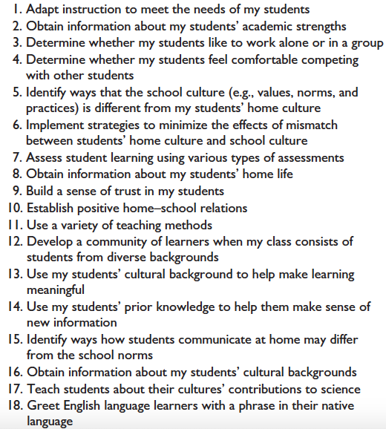
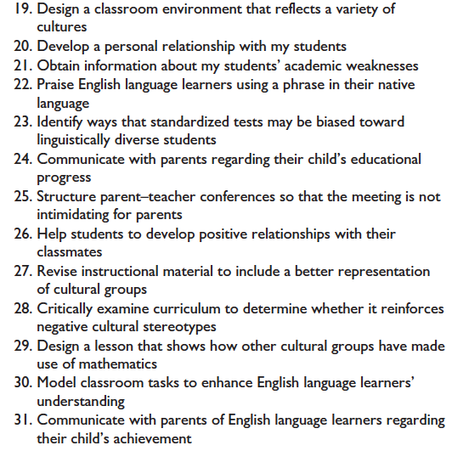
Table 3: CRTSE Questionnaire

Slide 21
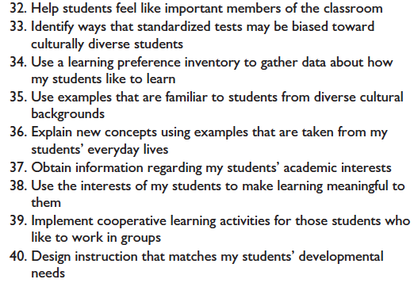
Table 3: CRTSE Questionnaire

Slide 22
RD: PROCEDURES
TPP CANDIDATE PERCEPTION OF CULTURALLY RESPONSIVE TEACHING SELF-EFFICACY
This study was undertaken as a response to GMU invitation for more university-school collaborative research. One of the researchers was a member of the newly formed college committee charged with the mission to facilitate and promote research at GMU in equity, diversity and cultural responsiveness. This study is exploratory in an effort to evaluate CRT practices within the broader context of theory and practice.
After obtaining IRB approval from the university based review board, we will recruit teacher preparation program participants by making direct contact via email. Potential candidates (~n=375) who meet criteria (student in CEHD, enrolled in TPP, goal to teach upon graduation) will be emailed an anonymous link to complete the survey via Qualtrics.
The open link will be posted in the CEHD weekly newsletter to reach the targeted sample. Upon clicking the link for the survey, respondents will be directed to the implied consent page that informed them of the research study

Slide 23
RD: PROCEDURES
TPP CANDIDATE PERCEPTION OF CULTURALLY RESPONSIVE TEACHING SELF-EFFICACY
purpose, the principal investigator’s contact information in the event they require additional information, affirmation that the respondent is 18 years of age or older and a current student in the teacher preparation program aspiring credentials. At the end of the questionnaire, participants will be re-directed to separate URL page that will ask them for their email address if they would be willing to participate in a follow-up interview and/or focus group. No email addresses or personally identifying information will be collected from respondents.
The questionnaire (Table 3) will focus on the personal and professional education experiences and perceptions of the candidates in close-ended questions using a Likert—like scale as well as open ended questions. The survey results will be reported as descriptive statistics and integrated into the overall findings. The email address and other identifying information was collected and will not be attached to the questionnaire data. The link to participate in the survey will remain open from August 2021 - September 2021.

Slide 24
RD: PROCEDURES
TPP CANDIDATE PERCEPTION OF CULTURALLY RESPONSIVE TEACHING SELF-EFFICACY
Follow up interviews will then be conducted in-person, virtually or via telephone, with respondents who indicated on the questionnaire that they would be willing to participate in the interview portion of this research study (anticipating 50%). Respondents will be grouped in teams of 14, with 2 people representing each of the seven departments in CEHD, Early Childhood Education (PreK-3rd grade)/Early Childhood Special Education (birth-age 5), Elementary Education (PreK-6th grade), Fine Arts Education (PreK-12th grade), Foreign Language and English as a Second Language Education (PreK-12th grade), Health and Physical Education (PreK-12th grade), Secondary Education (6-12th grade) and Special Education. The team interviews will be recorded so that the researchers can listen to how each candidate understands CRT, feels they are personally and professionally ready to implement CRT, and how they feel GMU is preparing them to be culturally responsive educators. Of the 500 anticipated participants, 36 interview teams will be created. Two researchers will be present in each interview, one to ask questions and one to take notes. The interviews will focus on the questions listed in Table 2. After the interviews, the responses will be analyzed holistically as the researchers look for convergence and divergence among the candidate responses and general patterns will be identified.

Slide 25
RD: PROCEDURES
TPP CANDIDATE PERCEPTION OF CULTURALLY RESPONSIVE TEACHING SELF-EFFICACY
Focus groups will be comprised by persons who identified on their survey that they would like to participate. (~ n=100). These groups will be recorded. Participants of the focus group will be asked open ended questions regarding their perception of their university program preparing them to be culturally responsive educators.
The deliberate redundancy in the instrument (questionnaire, interview, focus group) and methods of data collection are necessary and designed to give confidence and validity in the findings, which is important because actual observations in teacher classrooms and field placements are not appropriate due to the COVID closures.
All data will be verified and coded for analysis.

Slide 26
RD: ETHICAL CONSIDERATIONS
TPP CANDIDATE PERCEPTION OF CULTURALLY RESPONSIVE TEACHING SELF-EFFICACY
To avoid scientific misconduct, all candidates will be informed that:
The research study has received IRB approval.
They must provide informed consent if they wish to participate in the research study.
Candidates will receive confidentiality, anonymity and concept of privacy.
Their participation is voluntary and they have freedom to withdraw.
The researchers are not experts, and when sensitive information is shared researchers will address any issues rather than dismiss them as being outside the confines of the purpose of the study.
They will have protection from mental and physical harm.
(Chapter 6, Research Ethics)

Slide 27
RD: PROPOSED PRELIMINARY DATA ANALYSES
TPP CANDIDATE PERCEPTION OF CULTURALLY RESPONSIVE TEACHING SELF-EFFICACY
The findings of this study will reveal patterns of convergence and divergence of the teacher preparation candidates and their collective perceptions of cultural responsive teaching readiness/self-efficacy. Specifically, the data analyses will answer the intended research questions and present the findings from the questionnaire instrument, interviews and focus groups. The finding will show if there was 1) collective agreement among the candidates as measured by the questionnaire, 2) the candidates perception of their personal readiness to implement CRT, 3) professional readiness to implement CRT, 4) personal readiness to implement, 5) where the candidates are most and least efficacious, 6) if there is any differences based on gender, race or other demographics and 7) candidates perceptions of GMUs effectiveness in preparing them as culturally responsive educators.

Slide 28
RD: TRUSTWORTHINESS
TPP CANDIDATE PERCEPTION OF CULTURALLY RESPONSIVE TEACHING SELF-EFFICACY
Trustworthiness has been ensured by appropriate sampling, instrumentation and confirmability. Adequate transparency has been implemented.
Trustworthiness may be a factor if there are inadequate participant perspectives from underrepresented departments in CHED. If the majority of the respondent come from one department over another (e.g. Special Education over Physical Education) one department may have had more exposure to CRT principles than others.

Slide 29
REFERENCES
Cholewa, B., Goodman, R. D., West-Olatunji, C., & Amatea, E. (2014). A qualitative examination of the impact of culturally responsive educational practices on the psychological well-being of students of color. The Urban Review, 46(4), 574- 596.
Chu, S. Y., & Garcia, S. B. (2018). Collective teacher efficacy and culturally responsive teaching efficacy of inservice special education teachers in the United States. Urban Education, 0042085918770720.
Cruz, R. A., Manchanda, S., Firestone, A. R., & Rodl, J. E. (2020). An examination of teachers’ culturally responsive teaching self-efficacy. Teacher Education and Special Education, 43(3), 197-214.
Gay, G. (2002). Preparing for culturally responsive teaching. Journal of Teacher Education, 53, 106-116. doi: 10.1177/0022487102053002003.
Gay, G. (2010). Culturally responsive teaching: Theory, research, and practice (2nd ed.). New York, NY: Teachers College Press.
Gay, G., & Kirkland, K. (2003). Developing cultural critical consciousness and self-reflection in preservice teacher education. Theory into Practice, 42, 181-187. doi: 10.127/215430421tip4203_3
Johnson, R. B., & Christensen, L. B. (2020). Educational research: quantitative, qualitative, and mixed approaches (7th ed.). SAGE.
Judd, J. B. Practitioner Research as Catalyst for Culturally Responsive Teaching.

Slide 30
REFERENCES
Karataş, K., & Oral, B. (2017). Cultural responsive teaching readiness scale validity and reliability study. Eğitim Bilimleri Araştırmaları Dergisi - Journal of Educational Sciences Research, 7(2), 245-256. http://ebad-jesr.com/
Kea, C. & Trent, S. (2013). Providing culturally responsive teaching in field-based and student teaching experiences: A case study. Interdisciplinary Journal of Teaching and Learning, 3(2), 82-100.
Özüdogru, F. (2018). The Readiness of Prospective Teachers for Culturally Responsive Teaching. Acta Didactica Napocensia, 11, 1-12.
Paris, D., & Alim, H.S. (2014) What are we seeking to sustain through culturally sustaining pedagogy? A loving critique forward. Harvard Business Review, 81(1), 85-137.
Whitaker, M. C., & Valtierra, K. M. (2018). The dispositions for culturally responsive pedagogy scale. Journal for Multicultural Education.

